Slide 1

Reviews

Slide 2
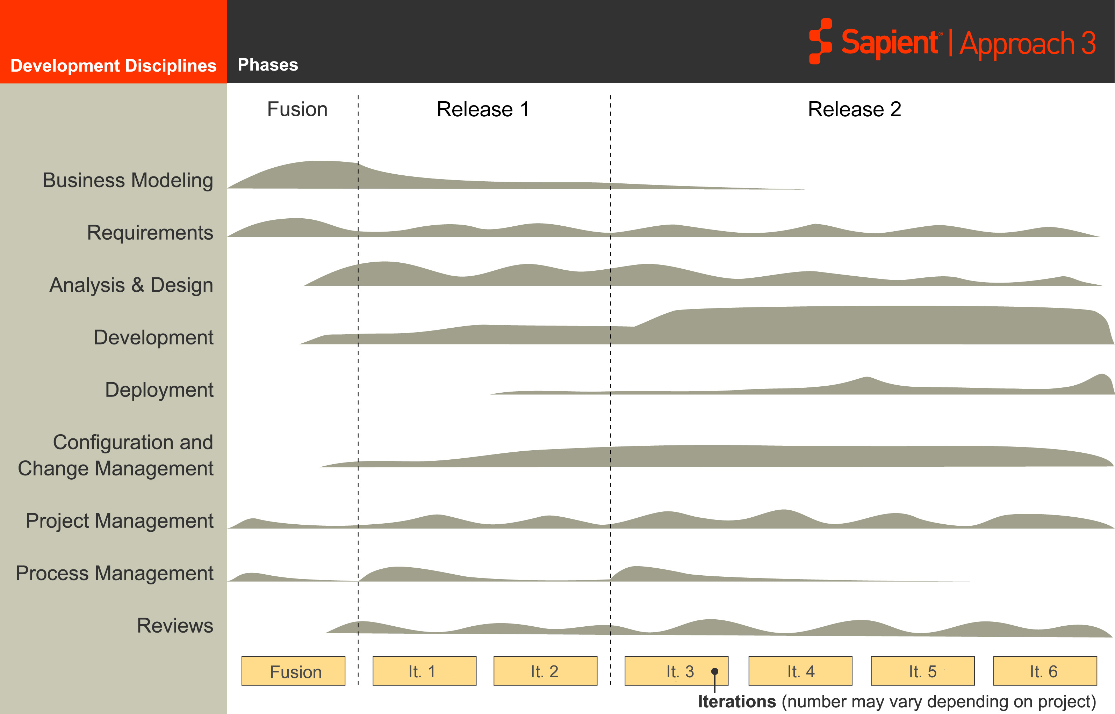
S|A 3 Project Life Cycle
Sapient|Approach 3
Disciplines
Fusion
EAR
Release 2
It 1
It 2
It 3
It 4
It 5
It 6
EAR
Reviews occur throughout the project life cycle

Slide 3
Analysis and Design Activities
Analysis & Design
Configuration Management
Project Management
Development
Project Management
Peer Review
Requirements
Progress Review
Reviews
CLEAR
Audit

Slide 4



Peer Review
Purpose:
  To identify and remove the defects early and ensure quality work products
Objective:
  To Improve the quality of work products
  To identify defects early
  To share knowledge about work products and best practices
Activities:
  Identify a reviewer for the work product
  Set-up a review meeting as soon as a work product is ready
  Log all the defect/review comments in the TAR Tracker
    Each P1 and P2 defect should be logged as a separate artefact in TAR tracker
    P3s and P4s can be clubbed and logged as a single artefact in TAR tracker
  Track all the defect/review comments to closure
Mandatory Artefact:
  Defects captured as tracker items in TAR Tracker and tracked to closure

Slide 5
Progress Review
Purpose:
  To evaluate the project risk
Objectives:
  Review progress of the project
    Once every 4 weeks for Create projects
    Once every 12 weeks for Manage projects
  Validate that teams are logging and resolving issues
  Discuss risks to the iteration and project and refine mitigation strategies
Activities:
  Schedule review
  Review the current iteration and release plans along with risks, TAR tracker and process review notes
  Review with PM, Architect and one or more Track Leads, if required to discuss delivery focus area report, overall project risks, contractual issues, etc
  Capture review notes and upload to Review Tracker
Output:
  Capture review notes in Reviews Tracker in RS2

Slide 6
Review Focus Areas
S|A compliance
Scope management
Issue and risk management
Communication
Planning and tracking
Relationships
Roles and responsibilities
Team morale and growth
Project profitability
Legal obligations
Project Management
and
Leadership
Commercial
Considerations
Focus
Areas
Technology
Solution
Functional
Solution
Logical/physical
Architecture
Data/integration
Architecture
Reliability
Performance
Usability
Accessibility
Fit for purpose
Business
Solution
Business Drivers
Measurable Business Results
Organisational readiness
Organisational design
Organisational change management

Slide 7
Collaborative Executable Architecture Review (CLEAR)
Purpose:
  To determine that EAR has been completed to an appropriate level of detail and quality in order to set the project up for successful delivery
Objective:
  Evaluate the risks in the project and check the ability of the project to mitigate them
  Identify delivery risks relating to the 5 Focus Areas
  Determine if the solution will have a high probability of delivering the promised client value
  Provide Senior Management and Clients visibility into key project risks
  Ensure projects leverage organizational knowledge and best practices early in the project lifecycle
Activities:
  Set-up CLEAR with the Progress Review Owner and Review Team Members
  PM to send the CLEAR presentation to the Review Team atleast a week in advance
  Capture the Review notes in the Reviews Tracker in RS2
Mandatory Artefact:
  Capture review notes in Reviews Tracker in RS2

Slide 8
Audit
Purpose:
  To monitor S|A compliance and to ensure that the teams across the organization are following S|A processes consistently
Objective:
  Monitor the level of compliance across the organization in adopting S|A processes and report this to Sapient leadership
  Highlight areas of non-compliances and work with teams to develop a plan to close them
  Identify potential Process Improvements for S|A
Activities:
  S|A consultant does an offline audit for the project (for repository and RS2)
  Online audit is done with the PM, Arch and other team members on a random basis
  Debrief Audit findings at the end of the audit
  Log Audit findings in the Adoption Tool
Mandatory Artefact:
  NCs and Observations logged in the Adoption Tool

Slide 9
Questions?

